Slide 1

Topic: Improving the customer experience of biryani by kilo
Submitted by Group 1:
Achintya Verma (B2020063)
Aditi Rawat (B2020064)
Adonis Claudius (B2020065)
Ameya Ambike (B2020066)
Asmita Purohit (B2020072)
Clarion Chacko (B2020077)
Partha Gautam (B2020095)
Pradyut Mishra (B2020098)
Urja Pathak (B2020120)
Varsha Satpathy (B2020122)

Slide 2
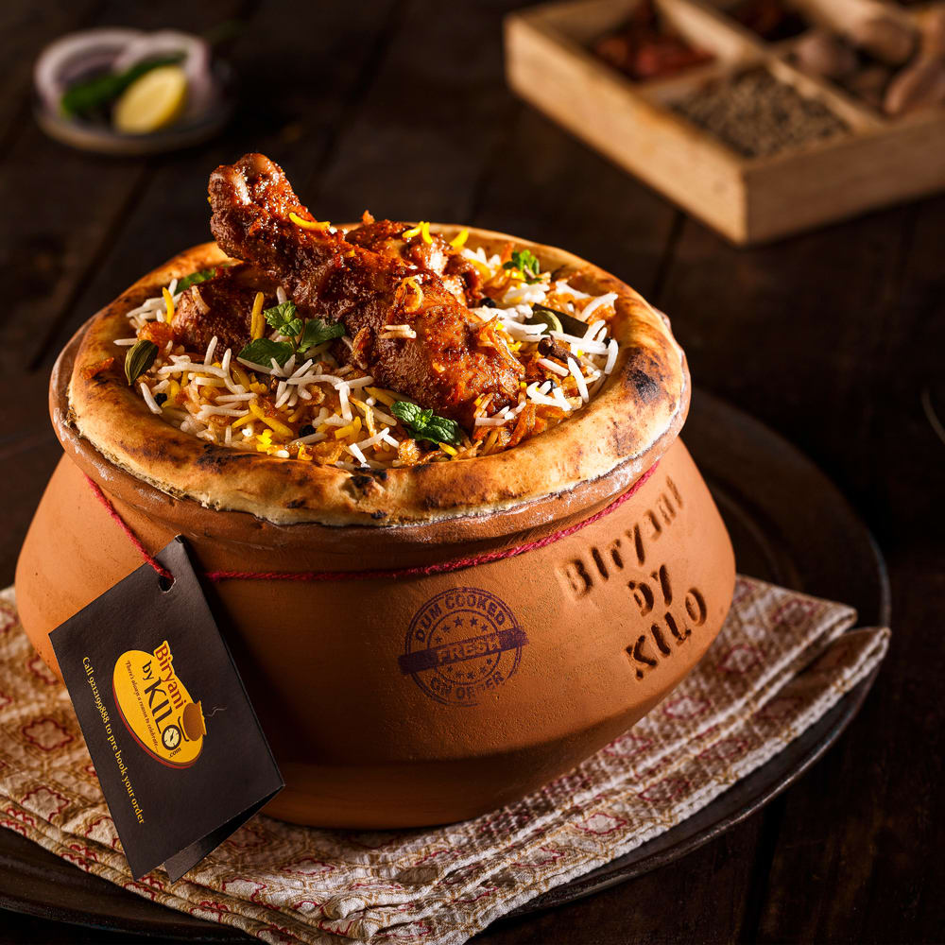
Background Info of Biryani By kilo
Biryani by kilo is food start-up founded in 2015, run by Gurugram based sky gate Hospitality Pvt ltd by two veterans of industry Kaushik Roy and Vishal Jindal. It is known for its Khansama cooking style, where in its Biriyani is freshly cooked for every individual order and delivers it in Handi in which it was cooked

Slide 3
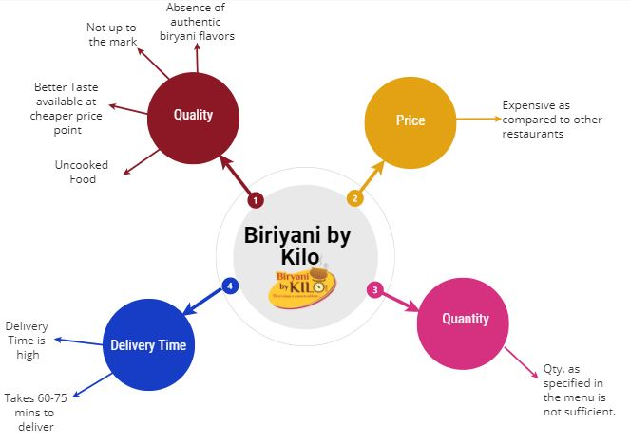
Creating the Mind-Map

Slide 4
Related Research to Support the Problem Statement
1) Price –
As stated in one of its customers' reviews that the price is very high as compared to its competitors. The price being paid for any order is more focused towards the packing instead of food quantity and taste.
2) Quantity -
The food quantity provided at this price is very less when compared with any of the mediocre restaurants with average ratings.
3) Delivery time -
It generally takes more than 60 mins to deliver a plate of biryani, whereas biriyani is a dish that is supposed to be served fresh in the least amount of time. Customers would always enjoy a dish of hot biryani.
4) Quality -
Customers in an almost unanimous voice said that, the quality of the so-beautifully packaged biryani, is that of low quality. At times, people complained of an uncooked portion in the pot, be it the main ingredient - rice or even the add-ons.

Slide 5
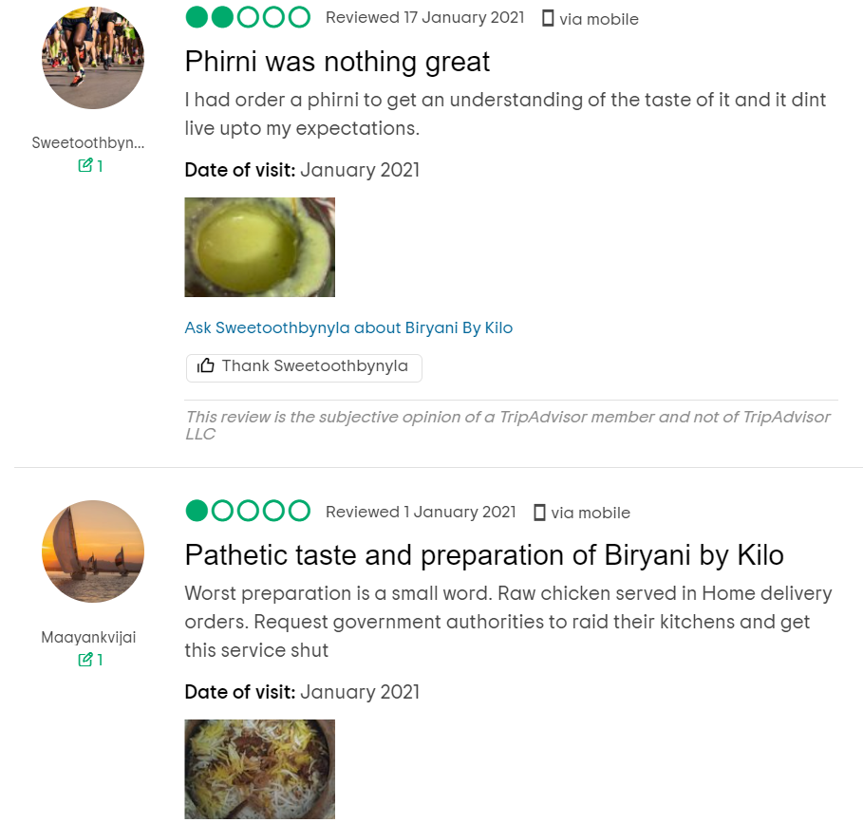
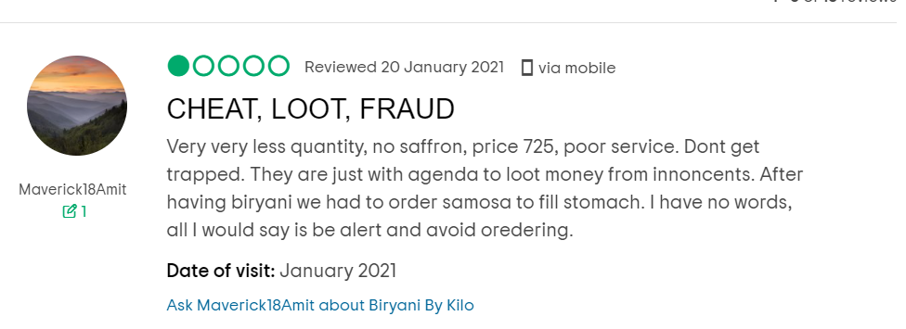
Related Research to Support the Problem Statement
Source-
https://www.tripadvisor.co.nz/ShowUserReviews-g644043-d11984939-r520219605-Biryani_By_Kilo-Noida_Gautam_Buddha_Nagar_District_Uttar_Pradesh.html

Slide 6
Problem Statement
The sales for Biryani by Kilo have gone down as most of the customers don’t prefer to order again. The reason for the customer dissatisfaction, based on the various customer reviews available on Google, could be traced down to quality, quantity, price and delivery time.

Slide 7
LIST OF OUTCOME METRICS
Cost Effective
High Quality
Better Taste
Decent Quantity
Aromatic
Fast Delivery
Hygienic Dine-In service
Online Presence

Slide 8
Process Lifecycle
Customer
Kitchen
Prepared order
Receive order
Order Processing
Order process
Update order to database
Update inventories
Sold food Items
Inventory Data
Database of items' sold
Generate Management Report
Inventory Database
Info about daily sold item
Info about daily inventory depletion amount
Restaurant Manager

Slide 9
STAKEHOLDERS
External
Vendors
Delivery partners
Internal
Admin and Managers
Chefs
Investors
End users
Waiters, Cleaning Staffs
Owners

Slide 10
MAPPING THE IMPACTOR/IMPACTEE
Impactee- Impactee is a person who is getting impacted. The impacts can be associated with production, operations, transportation etc. In our case, Impactee is a consumer who is facing issues of high price and lack of quality of the biriyani.
Impactor- Impactor is a person who is causing the impact. In our case people/management who is deciding the price and the chef who is preparing the dish is the impactor.

Slide 11
Map interviewees
Impactor to Impactee
Are you satisfied with the quality and taste of the biryani?
If you are not satisfied, what do suggest or what flavours to add?
What do you think about the price of biriyani?
Do you think the price is okay with the quantity which we are serving?

Slide 12
Map interviewees
Impactee to Impactor
Can the taste of biriyani be improved?
Can we match price and quantity of biriyani?
Can the restaurant be more focused on the taste rather than other stuff like, serving in Handi, presentation?

Slide 13
Identifying EPICS & Sub-epics
Quality
Improper raw materials to cook food
Focus more on presentation rather than taste
Price
Over-priced as small quantity of food is provided to the customers
Unable to match the expectation of the customer spending
Absence of authentic biryani flavours
Spending too much on food packaging
Delay in delivery

Slide 14
We need to prepare a set of questions in order to interview customers so as to know their perspective of the product and service provided by the industry.

Slide 15
SET OF QUESTIONS FOR INTERVIEWEE
Name:
Address:
Age:
Food Preference (Veg or Non-veg.):
Do customers like ordering online or eating out or home cooked?
Frequency of ordering online in a week.
When does a customer prefer to eat biryani?
What is the amount the food ordered usually by a customer?
What is the quantity of food ordered?
How much time an individual spends on social media?
Which social media is mostly used by the customers?
If Veg. then favorite biryani (give options), similarly if non veg. then favorite biryani (give options)
Reasons of why is it your favorite. (Describe an event)
What can be improved in the services provided? (keep this question subjective)
Does the customer support any social cause? If yes then what.

Slide 16

Native Observations
Our face to face Interview with Mr Prabhav Agarwal brought us to the below observations-
Being a biryani lover since childhood, he has got a very good taste of authentic biryanis which he found missing in biryani by kilos
The price compared to its quantity being provided is way too high and with no extraordinary tastes, people will hesitate to come and have its biryani again.
At times he ordered biryani through an online platform. But he faced a constant issue of late delivery.
He liked the way biryani by kilo served in a handi, but what he felt that is they spend more on improving the quality of the food, and can cut short other cost’s, it will be helpful for the company to retain its customer bas and maintain a good reputation

Slide 17

Empathy Map
What are they feeling?
Insights from Surveys and Interviews
Taste was not good.
Less quantity compared to price.
Good Hygiene maintained.
Behaviour of staff was decent.
Delivery time is more.
What are people saying?
Where do hear of/see the product?
They have a good team of people but need to work on taste of biryani.
People are willing to give it a try because of its popularity.
Pricing should be reduced to retain the customers.
Pro’s
Hygienic
Packaging
Marketing
Con’s
Unauthentic taste
Less quantity in comparison to price
Time taken to prepare is more which
Increases expected delivery time.
Advertisements- Billboards etc.
Social Media.
Friends and Family.
What do they do?
Biryani by kilo, prepares biryani as flagship cuisine and serves to customer by Online order and takeaway.
Triggers
Pains
Barriers
Hacks
Desired Gains
Current Delights
Craving of authentic Mughlai food.
Quicker preparation time
Run offer on ordering apps.
Expensive
Taste not up to the mark.
Customer retention
Pricing
Better quality of food.
Less preparation time
Low pricing
Salubrious
Good Packaging

Slide 18
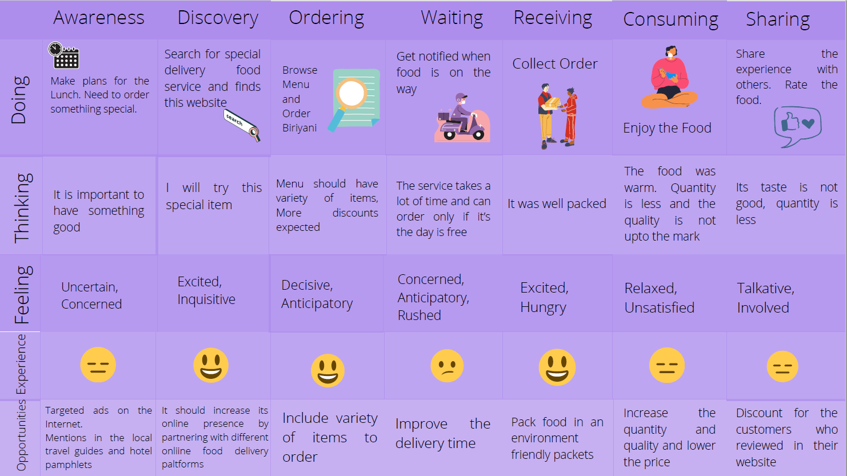
Customer Journey Map

Slide 19
Ideation Process
Pain Points | Quality | Quantity | Price | Delivery Time
Ideation Strategy | A set of good chefs can be arranged for, by way of a strong recruitment process. Automated quality checks to ensure good quality food is served. | On seeing customers not feeling content in the quantity served, the company can increase on it by thinking of compensating on a cost in another vertical. | The price of the biryani need to be decreased, as customers do not find it worth the cost. This can be done by minimising cost on other verticals like packaging and improving the quality of the serving such that it fits the cost charged for. | By tying up with quality logistic partners (like, Swiggy, Zomato, Uber Eats) and not depend on self can be one of the initial steps one can take to overcome this challenge.

Slide 20
Prioritization Grid
Maybe
Reducing Delivery Time
Efficient costing of food
Starting business in tier II cities
No
Increasing the no. of raw material vendors
Marketing/Advertisement in App
Maybe
Additional cashback offer in App
Appetizers, desserts & drinks
Yes!!!
Ensuring that food is cooked properly
Using good quality raw materials
Adding more flavors
Improve quality
High
User value
Low
High
Efforts by Organization
Low

Slide 21




DVF Scoring
Decrease the response time of orders placed.
Quantity and Quality of the food needs to be appropriate.
DESIRABILITY
Customer feedbacks should be encouraged and taken care.
Quality of work should be improved.
To get an authentic biryani experience.
Serve Quantity should be increased
FEASIBILITY
VIABILITY
The taste of biryani can be enhanced.
Quicker delivery.
Taste and Quality of Biryani should be taken care.
Pricing should be reconsidered.
Introduce Dine-in services.
Customer retention should be the primary goal.
Experienced team of chefs.
Pricing and Timely delivery of food.

Slide 22
Prototyping
Firstly, their customers are not satisfied with the taste of their biryani, hence they must work on the quality of the meal served and try to make it more authentic.
1. A set of good chefs can be arranged for, by way of a strong recruitment process.
2. Automated quality checks to ensure good quality food is served.
There are few paths that can be taken in order to improve on the price-quantity issue:
1. Either the prices should be reduced in order to balance the quantity that is being served
2. Else the quantity served should be increased, making them stand more by their name and decreasing the ‘overpriced’ perception of an average consumer.
3. They can spend less on packaging and more on the quality of meal.
By tying up with quality logistic partners (like, Swiggy, Uber Eats) and not depend on self can be one of the initial steps one can take to overcome this challenge.

Slide 23
FEEDBACK:
Upon recognising the problems faced by our
customers which are based upon the following metrics:
1. Quality improvement
2. Quantity improvement
3. Expensive to the pocket because of the costing
4. Untimely delivery
These metrics can be improved by working and implementing upon the roadmap created by us adhering to the time constraint. It will not only lead to the profit generation of the company being increased but also improvement in the customer retention rate altogether with the brand value.

Slide 24
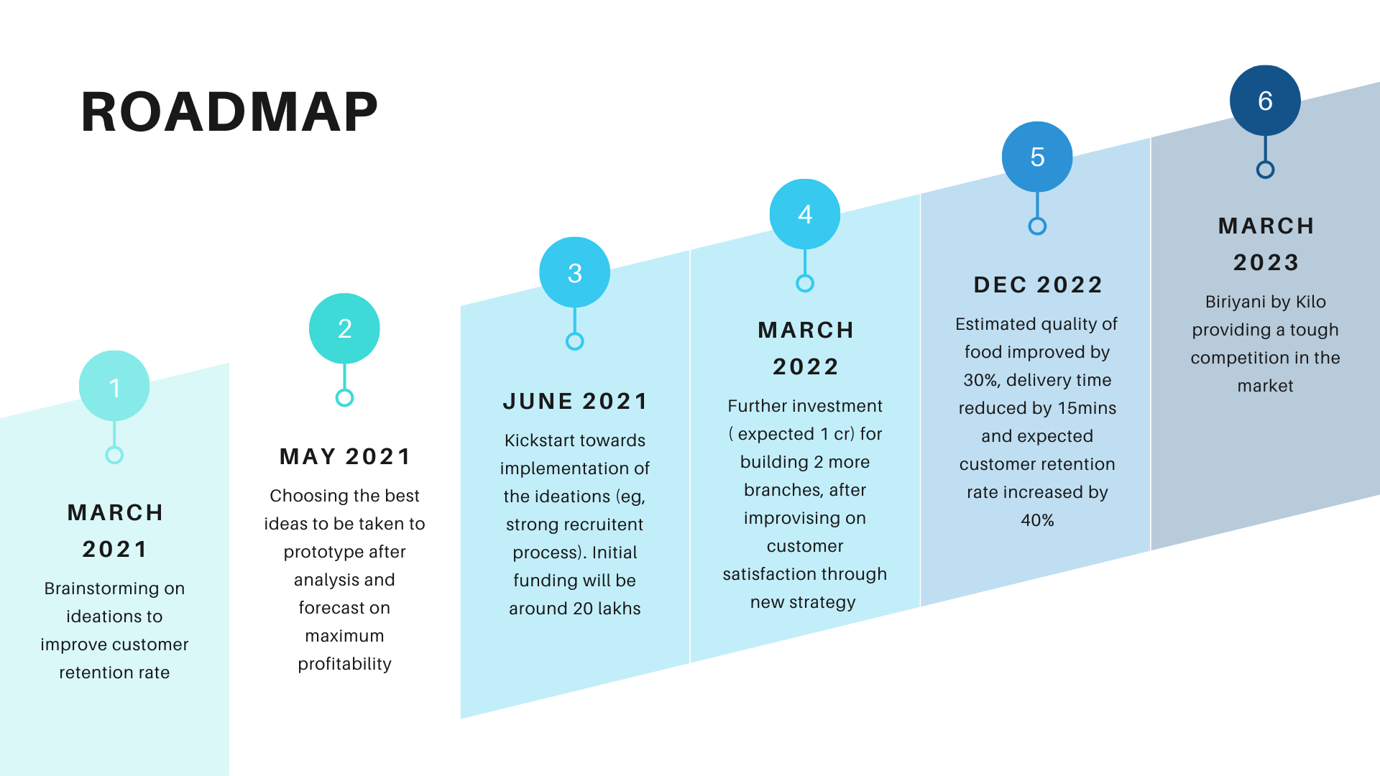

Slide 25
Measurement Metrics
Every bit of work and every penny invested are for nothing if you aren’t measuring their return. Metrics—the measurements by which you gauge an initiative’s success or failure (or other characteristics)
Following are some of the measurement metrics which will help us measure the performance of “Biryani by Kilo” after implementation of Design Thinking frameworks:
S no. | Description of metrics | Value
1 | No. of App Downloads
2 | Monthly Active Users
3 | Weekly Active Users
4 | No. of new Sign Ups
5 | No. of purchase for a new product
6 | No. of reviews collected
7 | No. of good reviews
8 | No. of customers returning to order
9 | No. of orders
10 | No. of new ideas incorporated
11 | Avg. time taken to deliver food
12 | No. of delays in delivery
13 | No. of complaints registered
14 | TAT for complaints
15 | Revenue generation
16 | Amt. invested in innovation
17 | Amt. invested in purchase of good quality raw material
18 | Societal Impact/support to local community (in monetary terms)
19 | Environmental Impact (in monetary terms)
20 | Market share
21 | Incentives offered to employees

Slide 26

Thank you!!

